Slide 1
Objectives
After completing this chapter you will be able to understand:
  What is Servlet?
  Servlet Life Cycle
  What is a Servlet Container?
  Servlet service Methods?
  Servlets Request and Response Interfaces.

Slide 2


What is a Servlet?
A servlet is a small Java program that runs within a Web server and serves the clients request hence the name servlets.
Servlets can receive and respond to requests from web clients (browsers) working on any client –server protocol , but HTTP is predominantly used.
Servlet is a server side script technology which can process client request and give back the response.
A web application will be made of one or more servlets..
Servlets runs inside the web server and process the request and sends response
HTTP Request
HTML response
CLIENT BROWSER
WEBSERVER

Slide 3

How Servlet Works ?
Assume a user is trying to login into Mphasis payroll support portal. The Web application has two servlets
Login Servlet for processing users login request
Registration Servlet for user to register in the web application.
Login Request - user name
and password sent to server.
WEB SERVER
Servlet Container
Login Servlet
Registration Servlet
If user valid the servlet sends a success response else sends a failure response.
Mphasis employee logs into by specifying user name and password and click login
Login Servlet queries database
validates the user credential .
Database

Slide 4
Servlet Container
A servlet container is a container for servlets which is responsible for managing the servlets.
The main functions are load, initialize and execute servlets to serve client requests.
When a request is received, the container decides what servlet to call based on a configuration file.
Servlet container comes installed with the web servers.
Examples:
Tomcat
Glassfish
Jboss

Slide 5
Older methods of Server Side Scripting
Common Gateway Interface (CGI) was the most commonly used for server side scripting before the evolution of the java servlet technology.
With traditional CGI, a new process is started for each HTTP request eating up more of the CPU cycles thus degrading the performance of the system.

Slide 6
Advantages of Servlets over CGI
A Servlet does not run in a separate process. This removes the overhead of creating a new process like CGI for each request.
A Servlet stays in memory between requests. A CGI program needs to be loaded and started for each CGI request. This way the servlet executes faster than CGI.
There is only a single instance of servlet which caters to all the HTTP requests concurrently. This saves memory and allows a Servlet to easily manage persistent data. On the contrary separate process and memory is allocated for each CGI/HTTP requests.

Slide 7
Servlet Life Cycle
Explain how the servlet container manages the servlet life cycle inside a web server.
Servlet
Step 1 : Web container loads the servlet class and creates a new instance of the servlet. The container can create a servlet instance at container startup or it can delay it until the servlet is needed to service a request.
Instantiation
Step 2: The servlet gets initialized during the first request with all the configurations set as per the configuration files.
First client request
Initialization
Step 3: The servlets service method would be invoked to process the HTTP request.
Response sent to client
Service
Servlet gets destroyed when application is undeployed from web server.
Destruction
NOTE: The step 1 and 2 will be executed only once in a servlet life cycle. The subsequent requests to the same servlet the container will only trigger step 3 to service all the request.

Slide 8

Time To Reflect
Associates to reflect the following topics before proceeding.
What is Servlet?
Why do you need a servlet container?
Advantages of Servlet over CGI?
What are all the phases of Servlet Life Cycle?

Slide 9
Servlet API
Servlet API’s are available in two packages,
javax.servlet : The classes and interfaces in javax.servlet are protocol independent . Eg: It can support different protocols like HTTP,FTP.
2. javax.servlet.http: The classes and interface in this package are specific for requests using HTTP protocol. Some of the classes and interfaces in the this package extend those specified in javax.servlet package

Slide 10
Classes in javax.servlet package
Interface | Class | Exceptions
Servlet | GenericServlet | ServletException
ServletRequest | ServletInputStream | UnavailableException
ServletResponse | ServletOutputStream
ServletContext | ServletRequestWrapper
ServletConfig | ServletResponseWrapper
Filter | ServletRequestEvent
FilterChain | ServletResponseEvent

Slide 11
Classes in javax.servlet.http package
Interface | Class | Exceptions
HttpServletRequest | HttpServlet | ServletException
HttpServletResponse | Cookie | UnavailableException
HttpSessionContext | HttpRequestWrapper
HttpSession | HttpResponseWrapper

Slide 12
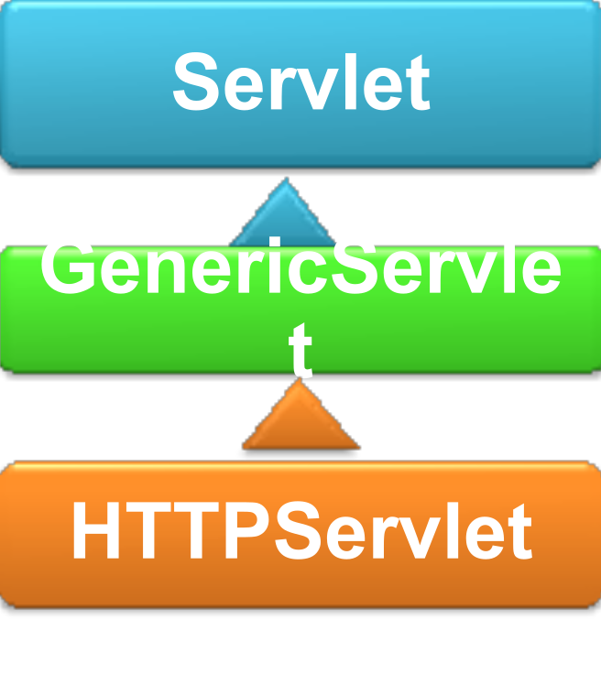
Servlet Class Hierarchy
Interface : Servlet
Declare the standard API’s which all the servlet implementations needs to define. All servlet classes must (fundamentally) implement this interface.
Class :GenericServlet
Defines a generic, protocol-independent servlet. Servlet developed to cater NON-HTTP requests.
Class : HttpServlet
Servlet used to cater client HTTP requests.
NOTE: We will be learning the commonly used HTTP servlets throughout this session.

Slide 13
Servlet Interface
The Servlet Interface is the abstraction of the Java Servlet API.
It declares the life cycle methods of a servlet.
All the servlet implementations must implement it either directly or indirectly by extending a class which implements the Servlet interface.
Example of Servlet implementations: HTTPServlet, GenericServlet.
NOTE: Since most of the application are internet based we will be using HTTPServlet class which implements the Servlet interface for processing HTTP requests.

Slide 14
Important Methods of Servlet Interface
Method | Description
void destroy() | Called by the servlet container to indicate to a servlet that the servlet is being taken out of service.
void init(ServletConfig config) | Called by the servlet container to indicate to a servlet that the servlet is being placed into service.
String getServletInfo() | Called by the servlet container to allow the servlet to respond to a request.
ServletConfig getServletConfig() | Returns a ServletConfig object, which contains initialization and startup parameters for this servlet.
void service(ServletRequest req, ServletResponse res) | Called by the servlet container to allow the servlet to respond to a request.

Slide 15
HTTPServlet
HttpServlet is an abstract class.
Any servlet which works on the HTTP should extend the HTTPServlet class.
This class contains implementation of methods that are specific to HTTP.
Also contains the implementation of the methods declared in the servlet interface.
Contains the doXXXX methods which are known as the service methods.
All the servlets extending this class should implement any one of the doXXXX() methods.
  Examples of doXXXX(): doGet(),doPost().

Slide 16
doXXXX methods in HTTPServlet
Method | Description
void doGet( HttpServletRequest req, HttpServletResponse resp) | Called by the server (via the service method) to allow a servlet to handle a GET request. Will be called when a URL is requested or the form method is GET.
void doPost( HttpServletRequest req, HttpServletResponse resp) | Called by the server (via the service method) to allow a servlet to handle a POST request. Will be called when the form method is POST.
void doHead( HttpServletRequest req, HttpServletResponse resp) | Receives an HTTP HEAD request from the protected service method and handles the request. Head request returns only the header information.
NOTE: Any class Extending the HTTPServlet should override any of the doXXXX methods based on the requirement.

Slide 17
doXXXX methods(Cont)
Method | Description
void doOptions( HttpServletRequest req, HttpServletResponse resp) | Called by the server (via the service method) to allow a servlet to handle a OPTIONS request. OPTIONS method is used by a client to determine the HTTP methods supported by a Web server.
void doPut( HttpServletRequest req, HttpServletResponse resp) | Called by the server (via the service method) to allow a servlet to handle a PUT request. Used to store an entity in the specified URI.
void doTrace( HttpServletRequest req, HttpServletResponse resp) | Called by the server (via the service method) to allow a servlet to handle a TRACE request.
void doDelete( HttpServletRequest req, HttpServletResponse resp) | Called by the server (via the service method) to allow a servlet to handle a DELETE request. Delete request is used to delete the information corresponding to that URI.
NOTE: In projects the doGet & doPost are commonly used.

Slide 18
Important Interfaces in Servlet API
HTTPServletRequest
HTTPServletResponse
ServletConfig
ServletContext
RequestDispatcher
NOTE: You will learn more about this in the subsequent slides.

Slide 19
Time To Reflect
Associates to reflect the following topics before proceeding.
What is the difference between Servlet, GenericServlet and HttpServlet?
What are init and destroy methods ?
What is the use of doGet and doPost methods ?

Slide 20
HTTPServletRequest Interface
This interface extends the ServletRequest interface contains methods to access request information by the HTTP servlets.
This interface is used by servlets to access,
The parameters sent by client as part of HTTP request from the browser.
Client Information like port number, client protocol, the form field values.
The servlet container creates an request object and passes to the service methods(doGet, doPost etc) as an argument. This object contains the entire user request information sent from the browser.
ServletRequest
HTTPServletRequest

Slide 21
Important Methods in ServletRequest
Method | Description
String getParamter(String parameterName) | Returns the value of a request parameter as a String or null if the parameter does not exist.
Enumeration getParamterNames() | Returns an Enumeration of String objects containing the names of the parameters contained in this request.
Map getParameterMap() | Returns a java.util.Map of the parameters of this request.
String [ ] getParameterValues(String paramterName) | Returns an array of String objects containing all of the values the given request parameter has, or null if the parameter does not exist.
String setAttribute(String attributeName,Object attributeValue) | Stores an attribute in this request.

Slide 22
Important Methods in ServletRequest(Cont)
Method | Description
Void removeAttribute(String attributeName) | Removes an attribute from this request.
String getAttribute(String attributeName) | Returns the value of the named attribute as an Object, or null if no attribute of the given name exists.
Enumeration getAttributeNames() | Returns an Enumeration containing the names of the attributes available to this request.
RequestDispatcher getRequestDispatcher(String path) | Returns a RequestDispatcher object that acts as a wrapper for the resource located at the given path.
Locale getLocale() | Returns the preferred Locale that the client will accept content in, based on the Accept-Language header.

Slide 23
List of other Methods in ServletRequest
The below listed are the other methods in ServletRequest interface used for getting more details on the request received.
getCharacterEncoding()
getInputStream ()
getContentLength ()
getContentType ()
getProtocol ()
getRemoteAddress ()
getRemoteHost ()
getScheme()
getserverName ()
getServerPort ()
isSecure()

Slide 24
Important Methods in HTTPServletRequest
Method | Description
Cookie [ ] getCookies() | Returns an array containing all of the Cookie objects the client sent with this request.
String getQueryString() | Used to get the query String from the URL. Always better to use the getParameter method for reading the query arguments since the the string returned using the getQueryString method needs to be parsed to get the values.
HTTPSession getSession() | Returns the current session associated with this request, or if the request does not have a session, creates one.

Slide 25
HTTPServletResponse Interface
HTTPServletResponse is an interface contains methods for managing the response send by an HTTP servlet to the client.
It also contains a set of status codes for sending the request status to the client.
Extends the ServletResponse and contain methods specific to HTTP.
The container creates a HttpServletResponse object and pass it as argument to the service methods for handling the response. The servlet can use this response object for managing the response.
ServletResponse
HTTPServletResponse

Slide 26
Important Methods in ServletResponse
Method | Description
PrintWriter getWriter() | Returns a PrintWriter object that can send character text to the client.
void setContentType(String type) | Sets the content type of the response being sent to the client.
void setLocale(Locale locale) | Sets the locale of the response
Locale getLocale | Returns the locale specified for this response set by the setLocale method.

Slide 27
Important Methods in HTTPServletResponse interface.
Method | Description
void sendRedirect(String location) | Returns a PrintWriter object that can send character text to the client.
void sendError(int sc, String msg) | Sends a temporary redirect response to the client using the specified redirect location URL
void addCookie(Cookie cookie) | Adds the specified cookie to the response. This method can be called multiple times to set more than one cookie.
void setStatus(int satusCode) | This method is used to set the return status code when there is no error.

Slide 28
Time To Reflect
Associates to reflect the following topics before proceeding.
What is HTTPServletRequest interface ?
What is the API method used for retrieving a parameter from the HTTP request?
What is HTTPServletResponse interface ?

Slide 29
Lend a Hand: Exercise # 1- Your first Servlet
You have successfully completed the basics of Servlets. Now it is time for creating the first servlet.
Software Prerequisites
Eclipse IDE (SDE)
Tomcat installation.
You will complete this in two phases
Phase I – Configuring web server and IDE.
Phase II – Develop the first servlet.
Trainers expected to demonstrate each slide and associates to try it out parallel in their desktops.

Slide 30
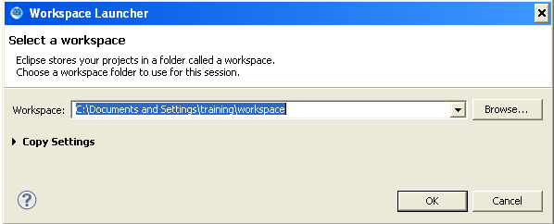
Phase I- Creating workspace
Step 1 :Open SDE
Step 2:Go to File→Switch Workspace→ Other
Enter the workspace name and press ok. SDE will restart with the newly created workspace.

Slide 31
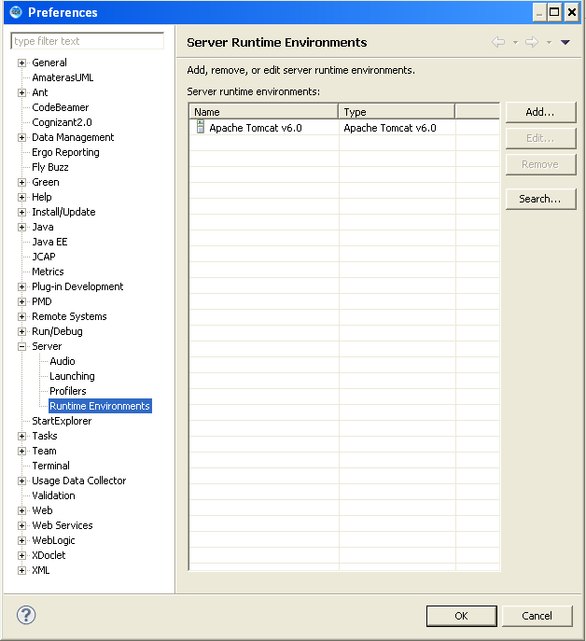
Phase I - Adding a Server Runtime Environment
Go to Windows→preferences→Server →Runtime Environments
Click on add and add Tomcat as the runtime environment.

Slide 32
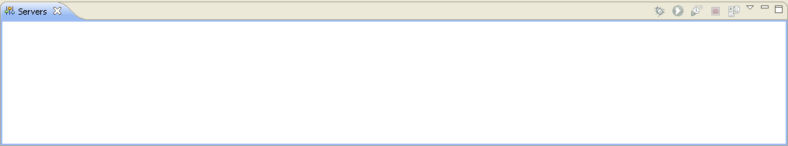
Phase I -Adding Web Server
Go to the Server View
Windows → Show View →Servers

Slide 33
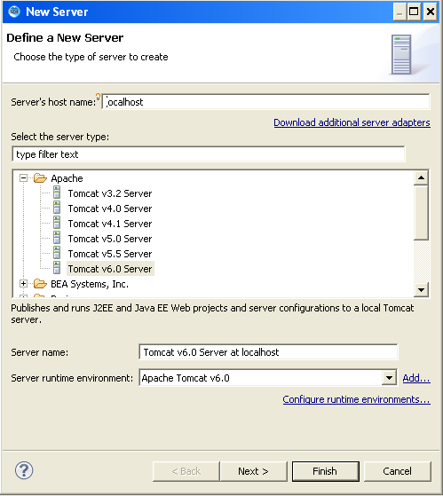
Phase I - Add a New Server
Right click on the Server View→ new → server→ Select the server and add a Tomcat server.

Slide 34
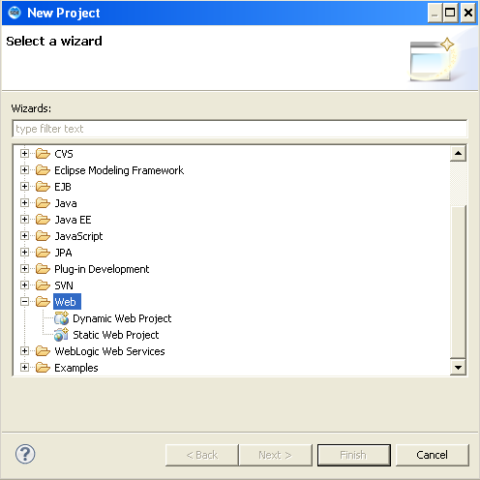
Phase I – Creating a Web project
Create a dynamic web project in SDE
File → New → Project → Web →Dynamic Web Project

Slide 35
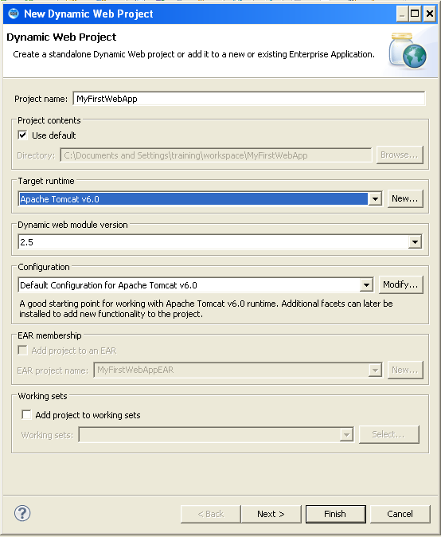
Phase I -Creating a Web Project
Enter the project Name and select the target runtime as shown below.

Slide 36
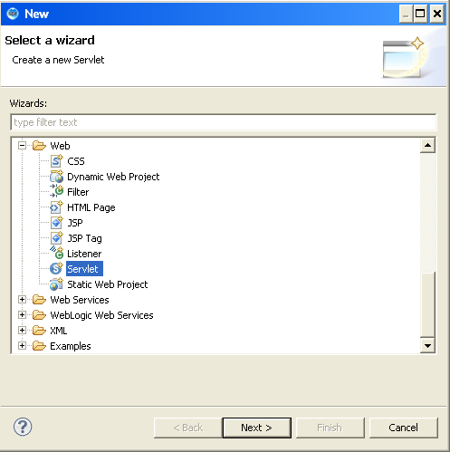
Phase II – Step 1: Add a servlet
Right Click Project → Click New → Web → Servlet

Slide 37
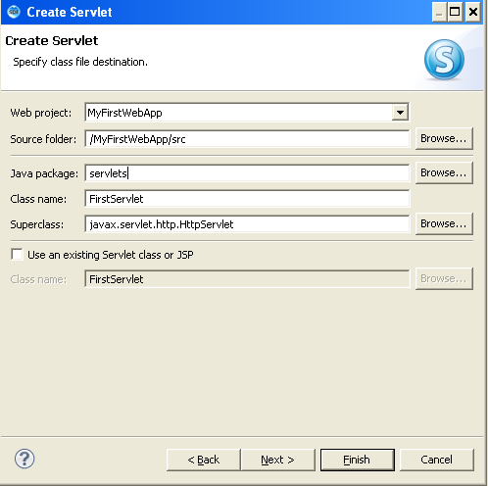
Phase II - Step 2: Adding Servlet
Enter the servlet name

Slide 38
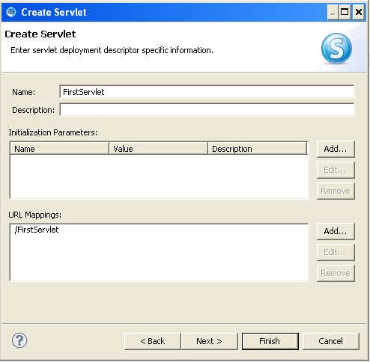
Phase II - Step 3: Adding Servlet
The screen shows the option for setting initialization parameters and URL mapping. For the time being will not alter the values.

Slide 39
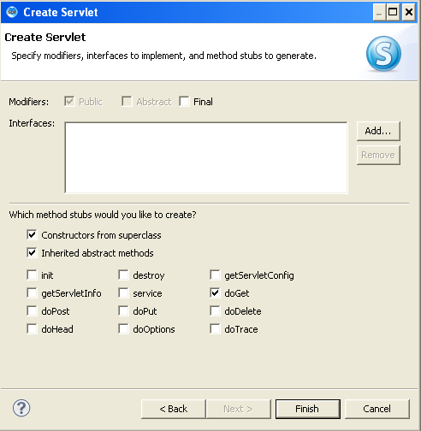
Phase II – Step 4: Adding Servlet
Select the doXXXX methods to be overridden . At present we will select only the doGet method.

Slide 40
Phase II - Step 5: Configuring WEB.XML
What is web.xml file ?
Web.xml is a configuration file which captures the application configuration and deployment details of a web application.
Some important configurations in Web.xml file:
context-param
servlet
servlet-mapping
welcome-file-list
Notes:
To the Trainer
The trainer can ask the associates regarding their idea on web.xml. After a small discussion the description can be shown.
Ask the associates to open the web.xml file inside the web-inf directory.
Explain that <web-apps> is the root tag of the xml file.
context-param is used for declaring context level parameters which means the values which are accessible throughout the application context.
Servlet : user for declaring the servlet. The servlet initialization parameters should be declared inside this .
Servlet-mapping – Used for mapping the servlet with a url
Welcome-file-list used for specifying the welcome file for the application
Now ask them to create a servlet named loginServlet in the application and ask them to view the xml file again with the servlet mappings.
Add the initial parameter for the servlet using the <init-param> tag as shown
<init-param>
<param-name>adminUser</param-name>
<param-value>administrator</param-value>
</init-param>
The above lines should be inserted inside the servlet tag.
The trainer should also explain that the initialization parameters for each servlet should be declared inside the <servlet> tag of the appropriate servlet
Declare the context parameter
<context-param>
<param-name>databaseName</param-name>
<param-value>Oracle</param-value>
</context-param>
Also show them how to configure the welcome file for the web application.
Create a login.html file inside the webcontents directory and ask them to make it the welcome file of the application.The login page should contain a username and password field and a submit and reset button.
Login.html
<!DOCTYPE html PUBLIC "-//W3C//DTD HTML 4.01 Transitional//EN" "http://www.w3.org/TR/html4/loose.dtd">
<html>
<head>
<meta http-equiv="Content-Type" content="text/html; charset=ISO-8859-1">
<title>Login</title>
</head>
<body>
<form action="LoginServlet" method="get">
<table>
<tr>
<td>User Name</td>
<td><input type="text" name="username" id="userName"/></td>
</tr>
<tr>
<td>Password</td>
<td><input type="password" name="password" id="password"/></td>
</tr>
<tr>
<td>
<input type="submit" value="login"/>
</td>
<td><input type="reset" value="clear"/></td>
</tr>
</table>
</form>
</body>
</html>

Slide 41
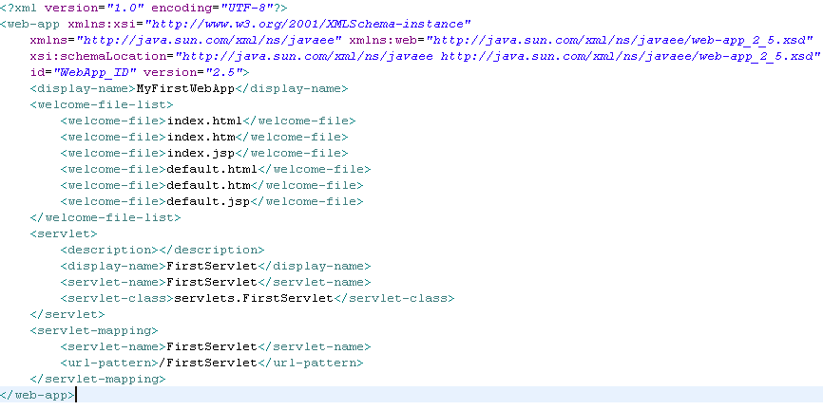
Configuration File (web.xml)
Lets view the configuration file (web.xml)
Go to webcontent → web-inf and open the web.xml file.
Can be used to set the welcome file for the application
Sets a name for referencing the servlet class
Used for mapping the servlet to a URL

Slide 42
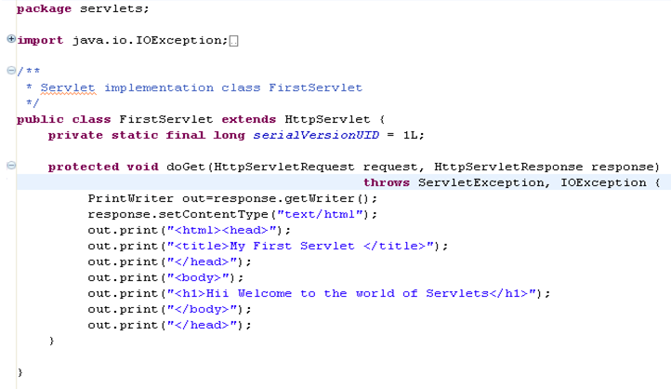
Lets Look at the servlet Code
Open the servlet source file and look at the doGet method generated automatically
Step 1: The servlet extends HTTPServlet
Step 2: The doGet method should be overridden by the developers.

Slide 43
Deploy and Run the application
Right Click The Application → Run As→ Run on Server
When the application gets loaded call the servlet as shown below
http://localhost:8000/MyFirstWebApp/FirstServlet
where FirstServlet is the URL mapping provided in the web.xml file.

Slide 44
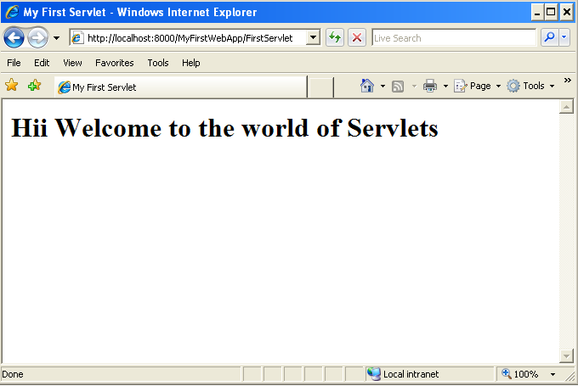
Output Screen Shot

Slide 45


Slide 46
Lend a Hand : Exercise # 2- Demo on Servlet Life Cycle Methods
In this demo we will be familiarizing the life cycle methods of a servlet
The three life cycle methods demonstrated are:
init
Service ( we will use the doGet method)
destroy

Slide 47
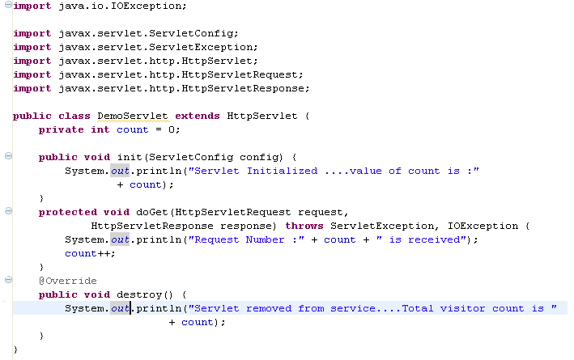
Servlet Code for Demo
Create the demo servlet as illustrated below.
Step 1: The servlet extends HTTPServlet
Step 2: Create the init method.
Step 3: Develop the doget method
Step 4: Develop the destroy method

Slide 48
How to Run The Demo
Step 1 : Deploy the application and call the servlet from browser
For the first call (Request) we can see the message “Servlet Initialized ....value of count is :0” printed on the console. This phase is the initialization phase of the servlet and hence the init() method will be called.
Step 2: Refresh the browser
You can see the message “Request Number :1 is received” printed in the console.This is the service phase and hence the doGet() method will be called.
Step 3: On each subsequent refresh the Request number can be seen incremented. Again the doGet() method will be called.
Step 4: Stop the server
We can see the message “Servlet removed from service....Total visitor count is <countValue>” printed in the console. This is the destruction phase of the servlet and hence the destroy() method will be called.

Slide 49


Slide 50
Lend a Hand : Exercise # 3-Form Handling with Servlets
Now lets develop a HTML form and servlet to demonstrate how form parameters are handled in server using servlets.
Step 1 : Create a login.html with a user name and password
Step 2 : Create a LoginServlet to handle the request
Step 3 : Create a SuccessServlet to display the success message

Slide 51
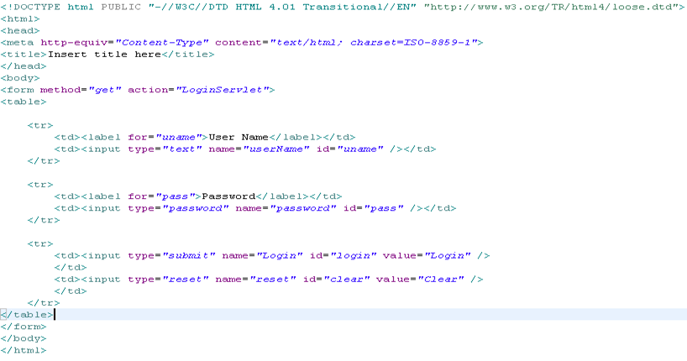
Step 1: Lets create a login.html
Create an HTML page named login.html under the webcontent directory.
Action Servlet for the login page. This should be the same as the URL mapping created for the servlet
Create the form text fields and submit buttons as mentioned.

Slide 52
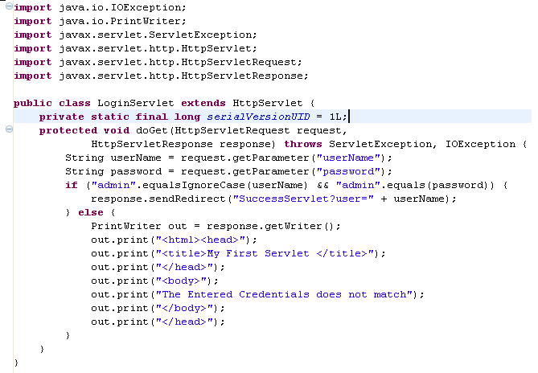
Step 2: Lets create the LoginServlet
Create an LoginServlet to handle the HTTP request from the form as mentioned below.
Reads the Request Parameters
Redirects the client to a new URL. Sets a value as query string to the next servlet

Slide 53
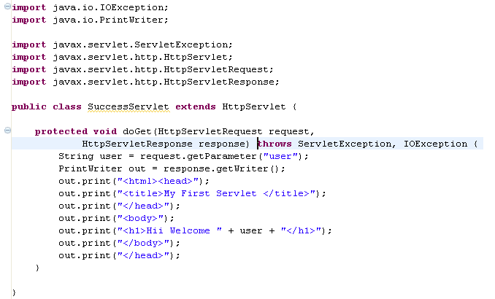
Step 3: Lets create the SuccessServlet
Create an SuccessServlet to handle the success request as mentioned below.
Reads the Query String parameter value

Slide 54
How to Run The Demo
Step 1 : Deploy the application
Step 2 : Call the login html from the browser
http://localhost:8000/MyFirstWebApp/login.html
Step 3 : Enter the username and password as “admin” and press login button you will be redirected to SuccessServlet
Step 4: Enter some other value for username and password and press login button. You will get the error message printed using LoginServlet.

Slide 55


Slide 56
Hands on Exercise: How Post method works ?
Hope you have completed form handling with HTTP get method. Now let’s do the same with post method .
Steps to be followed
Step 1 : We will reuse the same components we have developed
Step 2 : Change the form method post
Step 3 : Override the doPost method inside the LoginServlet and move the code from doGet to doPost
Step 4 : Deploy and run the application.
Step 5 : Notice the difference in browser with change in HTTP method.

